Slide 1
Volunteer Appreciation
Trivia

Slide 2
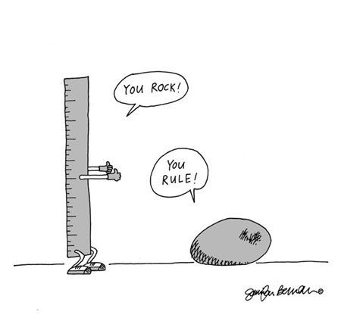
Ground Rules
No more than 6 players per team
Creative team names are encouraged
One answer sheet per team
You may not phone a friend (this includes texting and Google)
Use quiet voices to communicate within your team (no shouting answers)
Notes:
Make sure all settled
Any Questions?

Slide 3
Around the City
Questions about Newcastle landmarks

Slide 4
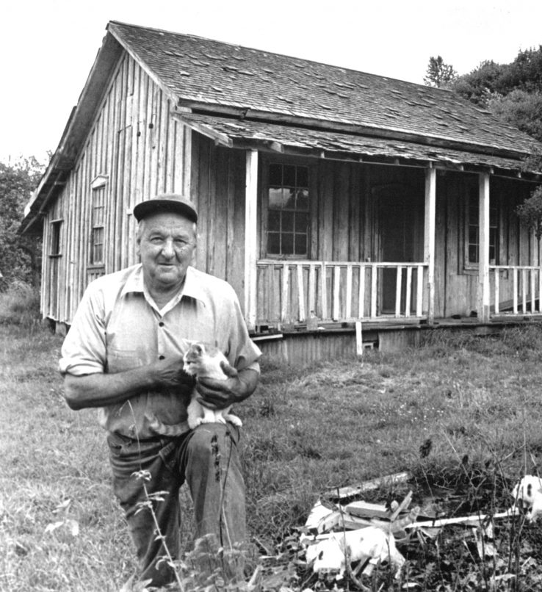
1. In 1982, King County designated Company House No. 75 as a historical landmark. This landmark is the last surviving residence of the Pacific Coast Coal Company. Locally, this house is known by what name?
Photo credit: Seattle Times
Notes:
Company House No. 75 is know locally as?

Slide 5
2. One thousand bibliophiles visited this 11,000 square-foot, green-roofed building when it opened on December 8, 2012.
Notes:
What is this green-roofed building in Newcastle?

Slide 6
3. This newly completed boardwalk trail allows pedestrians to complete a 1.4 mile loop around Lake Boren.
Notes:
What is the name of the boardwalk trail on the north side of Lake Boren?

Slide 7
Newcastle Past and Present
Name that Tune

Slide 8
1. When Newcastle was incorporated in 1994, this song was at the top of the pop charts.
Notes:
Ace of Base The Sign

Slide 9
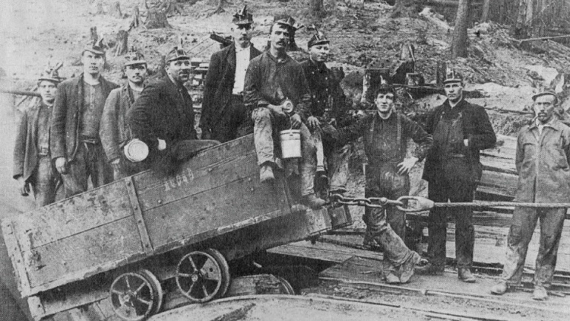
2. Newcastle was one of the most successful coal mining towns in northwestern Washington. Nearly 11 million tons of coal was extracted from the area between 1869 and 1963 and helped fuel the growth of the entire Puget Sound region.
Photo: Renton Historical Society
Notes:
What is the name of this song?
Loretta Lynn Coal Miners’ Daughter

Slide 10
3. When traffic is snarled on I-405 and Coal Creek Parkway has become an alternative route for people traveling to and from neighboring cities, you may feel like it will take this long to make it home.
Notes:
How long does it feel like it will take to get home?
Drake (or Eminem, Lil Wayne, Kanye West) Forever

Slide 11
4. A sub-committee of the Community Activities Commission plans strategies to recruit, retain and recognize City of Newcastle volunteers, including tonight's event.
Notes:
Kool and the Gang Celebration

Slide 12
Better Together
Questions celebrate the accomplishments of City of Newcastle volunteers

Slide 13
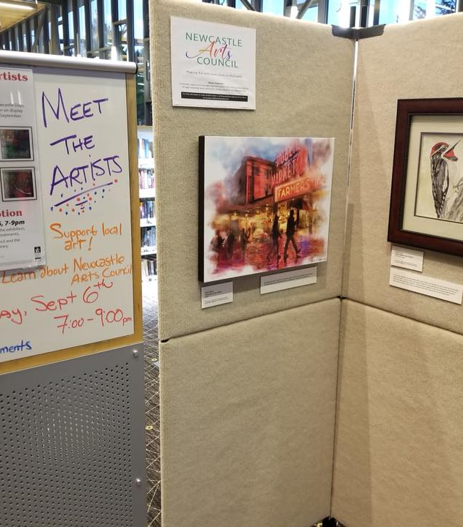
1. Encaustic on wood, graphite on paper, oil on canvas and digital art were just a few of the mediums displayed by 17 local artists at the Newcastle Area Artists Exhibition hosted by the Newcastle Arts Commission and the Friends of the Newcastle Library. How many years has this exhibition been a part of the Newcastle Days festivities?
Notes:
How many years has the Newcastle Artists Exhibition been a part of Newcastle Days? This was the first year!

Slide 14
2. Over 200 members of the Newcastle Community attended this Chamber of Commerce event that honors businesses, volunteers, students, non-profits and leaders of our sparkling community.
Notes:
What is the name of the Chamber of Commerce event?
Diamond Awards

Slide 15
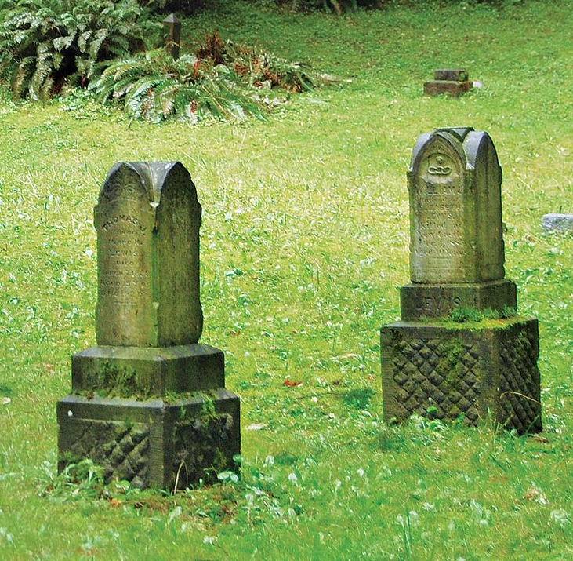
3. The Newcastle Historical Cemetery has served as the final resting place for coal miners and their families since the 1870s. Recent brush clearing organized by this volunteer group revealed the gravestone of Fred Gouley, who died in 1890.
Notes:
Which organization coordinates cemetery clean up events? Newcastle Historical Society

Slide 16
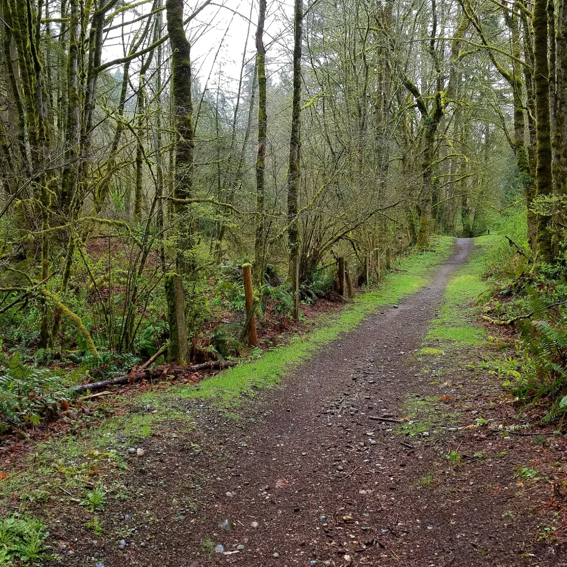
4. No matter how slow you go, you are still lapping everyone on the couch. Which two organizations have co-sponsored multiple group hikes for Newcastle area residents this past year?
Notes:
Which two organizations have co-sponsored group hikes this year? YMCA and Newcastle Trails

Slide 17
5. Annually, NYCE works in collaboration with the City, YMCA, and the library to create an event that addresses or solves a specific issue identified by the group. This year, to provide outlets for stress in a competitive educational atmosphere, NYCE sponsored a Teen Film Contest. These films were showcased during the Summer Movie Night.
What does the acronym NYCE stand for?
Notes:
What does the acronym NYCE stand for? Newcastle Youth Community Engagement

Slide 18
6. Good grief! There are so many tasks to complete in order to stage a community theater production.
Thanks to Newcastle area volunteers, the community enjoyed six performances of this musical comedy titled, “You’re a Good Man,
.”
Notes:
Who is the character portrayed in the center of this photo? Charlie Brown

Slide 19
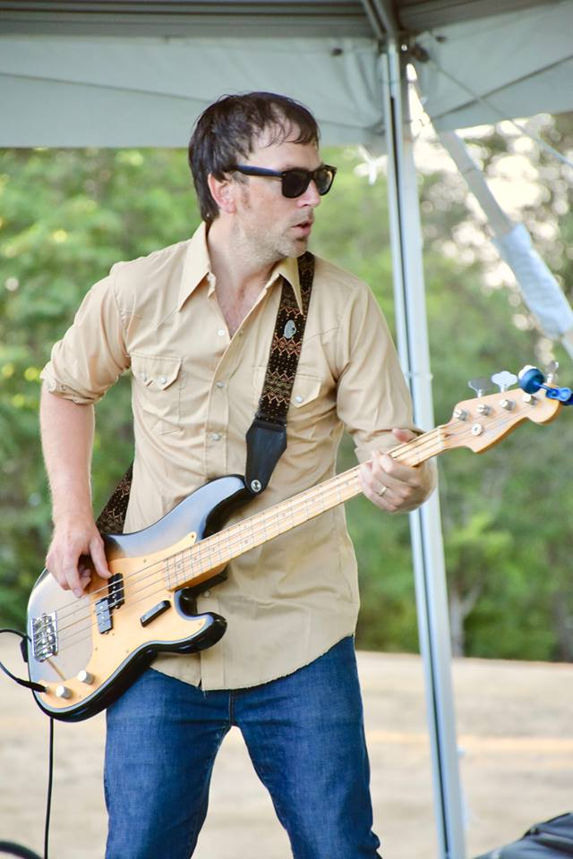
7. The Community Activities Commission selected bands to headline the 2018 Summer Concert Series. Which was not one of the summer concert bands? A. Shaggy Sweet B. Microsoft Jumpin' Jive Orchestra C. Hit Explosion D. Soul Purpose
Notes:
Which band was not a part of this year’s summer concert series? C. Hit Explosion

Slide 20
8. Where in Newcastle can you find a volunteer facilitator leading Girls Who Code, a program designed to close the gender gap in technology?
Notes:
Where is Girls Who Code hosted? Newcastle Library

Slide 21
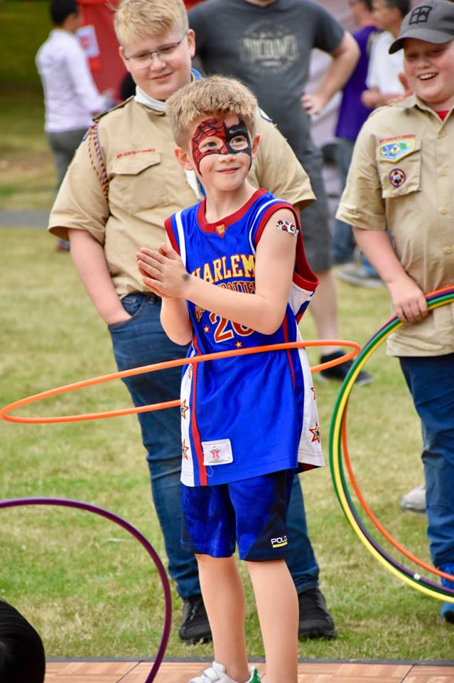
9. Boy Scouts Troop 499 volunteers in excess of 2000 hours each year in Newcastle and surrounding communities. Which of these projects are included? A. Street Cleanup B. Food Drive C. Document Recycling D. All of the Above
Notes:
Which if the listed volunteer projects include Boy Scouts Troup 499? D. All of the Above

Slide 22
10. These City of Newcastle volunteers developed recommendations to bring the city's sign ordinance into compliance in response to a U.S. Supreme Court decision (Reed vs. Town of Gilbert).
Notes:
Which group is developing recommendations to the City’s sign ordinance? Planning Commission

Slide 23
BONUS QUESTION
We are all Mathletes

Slide 24
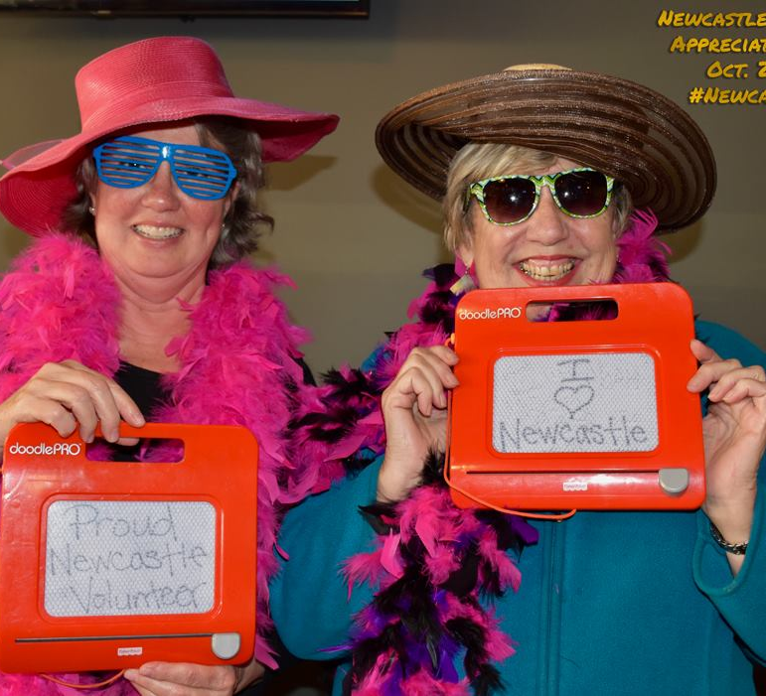
Attendees at tonight's event responded to the question "How many years have you volunteered in the City of Newcastle?" Based on the respondents' answers, what is the MODE of this data set?
Notes:
What is the MODE? Most frequently occurring number
So, the most volunteers have volunteered for how many years? 5-10

